Slide 1
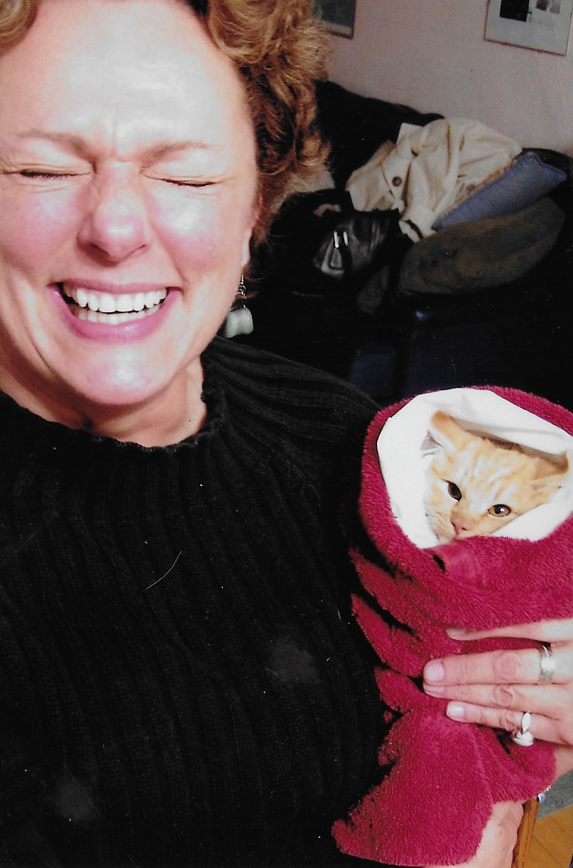
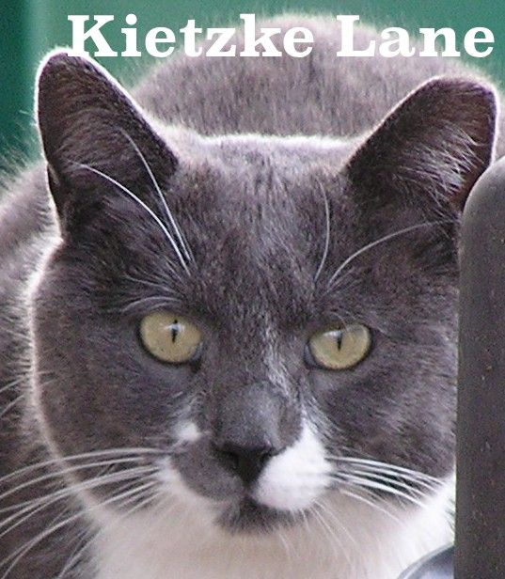
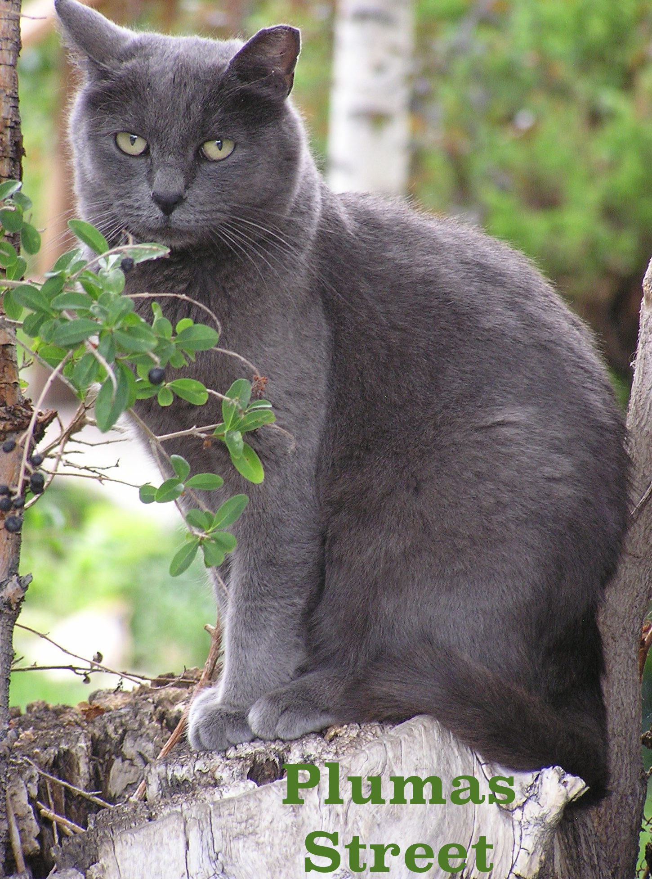
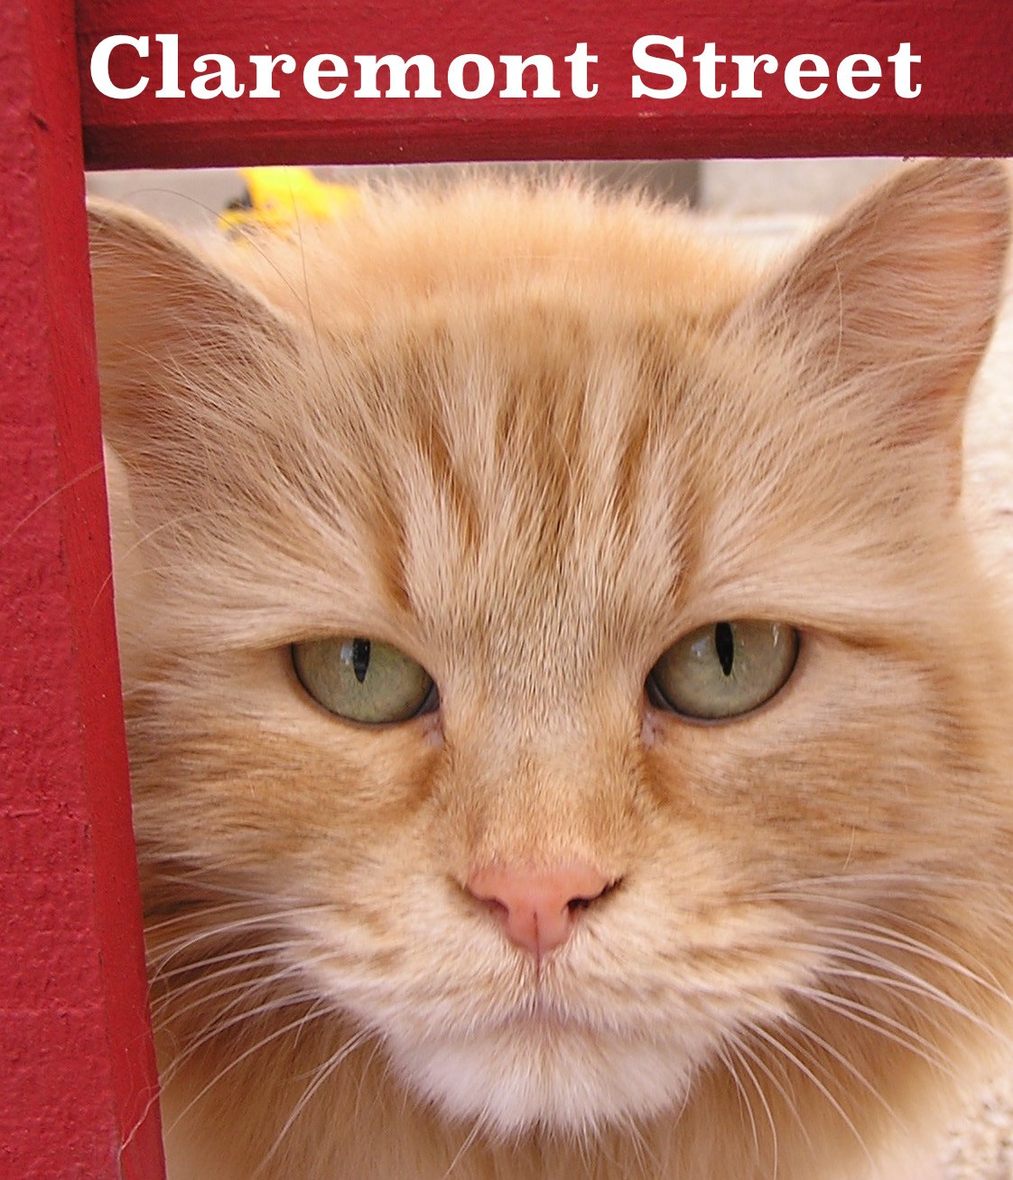

Community Cats
A 501(c)(3) non-profit local volunteer organization
25 Years
775-360-8053
CommunityCatsOfReno@yahoo.com

Slide 2

“The best solution to [community cat] issues is going to be significant changes in how people care for their cats.”
John Boone, PhD
Alliance for Contraception in Dogs and Cats Board of Directors Community Cats Podcast
Local Partners
Feral At Heart
Kitty Kisses Rescue Nevada Humane Society Options Veterinary Care
SPCA of Northern Nevada
Washoe County Regional Animal Services

Slide 3
NO-KILL STARTS WITH TNR
The population of cats entering our shelter is directly correlated to the cats breeding in our neighborhoods.
“The best solution to [community cat] issues is going to be significant changes in how people care for their cats.”
John Boone, PhD
Alliance for Contraception in Dogs and Cats Board of Directors Community Cats Podcast
On average, 80% of cats coming into shelters are from free-roaming cats.
It is in the best interest of all involved organizations to prevent the litters from being born in the first place.

Slide 4
“The best solution to [community cat] issues is going to be significant changes in how people care for their cats.”
John Boone, PhD
Alliance for Contraception in Dogs and Cats Board of Directors Community Cats Podcast
363 cats helped in 2022
552 cats helped in 2023
849 cats helped in 2024
Our numbers for helping cats went from an average of 54 per month January - November, 2024 to an astounding 130 in December 2024!
Washoe County’s commitment to TNR is a game-changer!
January-April 2025
562 cats helped 41 cats/kits off streets
Over 274 females spayed and Over 274 litters prevented since first
of year
If not spayed, these cats would be ready to deliver a 2nd litter NOW
April 2025 preliminary data

Slide 5
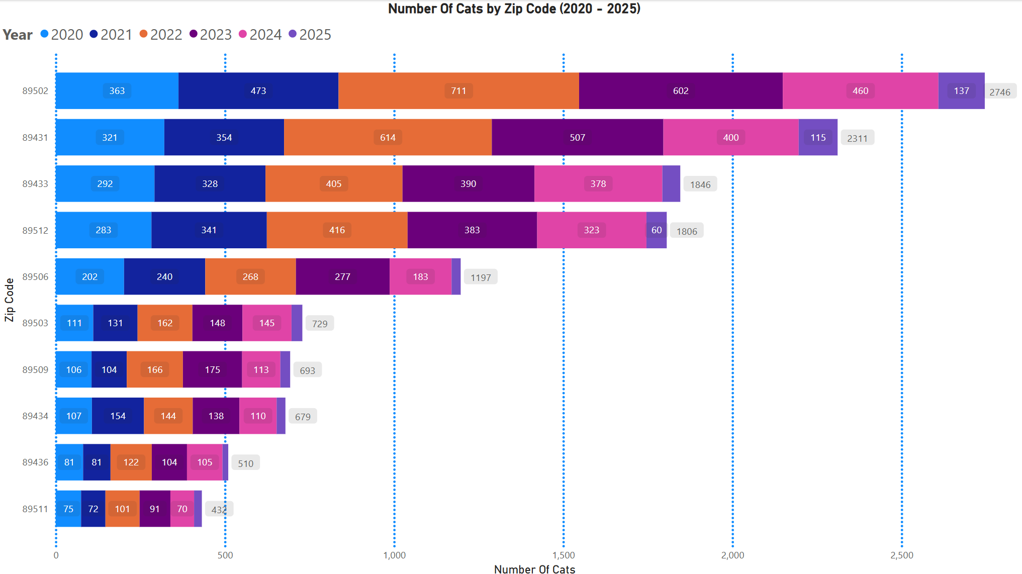
Thank you to Shyanne and her staﬀ for creating this zip code break out of cats coming in their doors.
We have our own zip code breakout numbers which will likely reflect similar data as this. In the near future, we hope to be able to show a "heat map" representing concentrated areas of free-roaming cat populations.

Slide 6
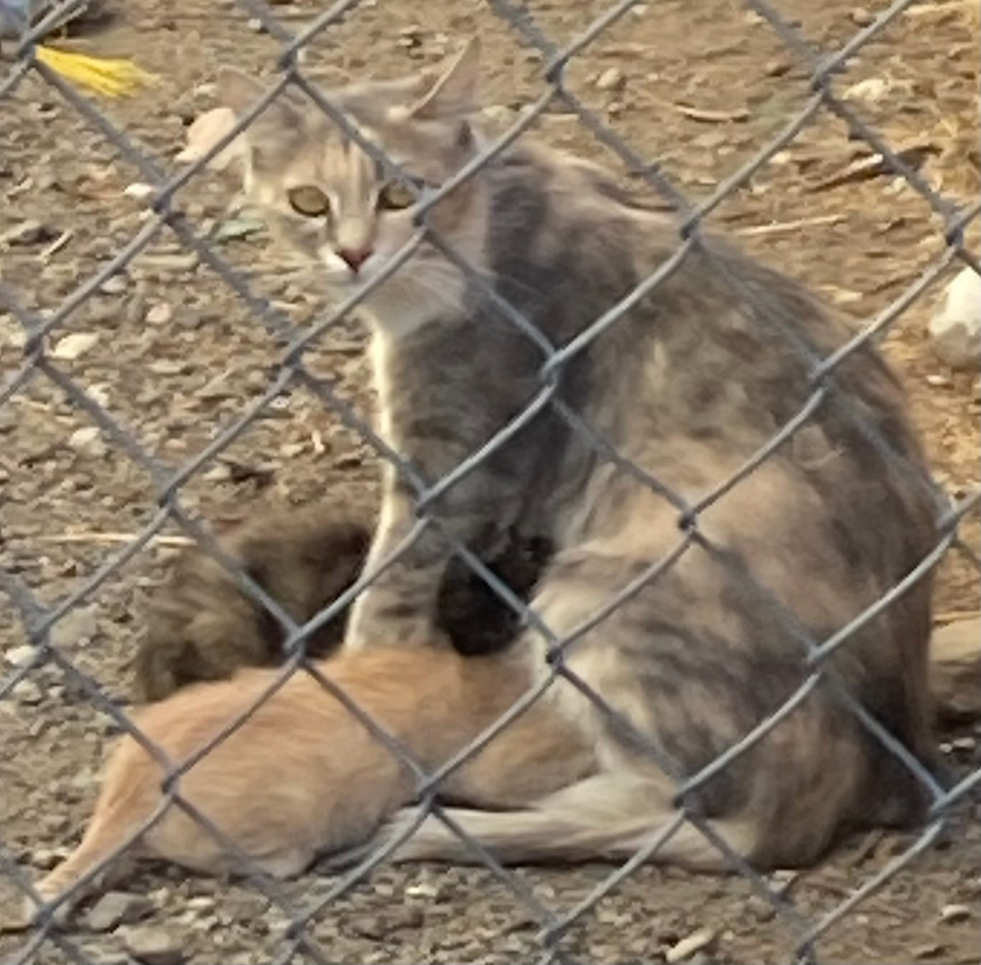
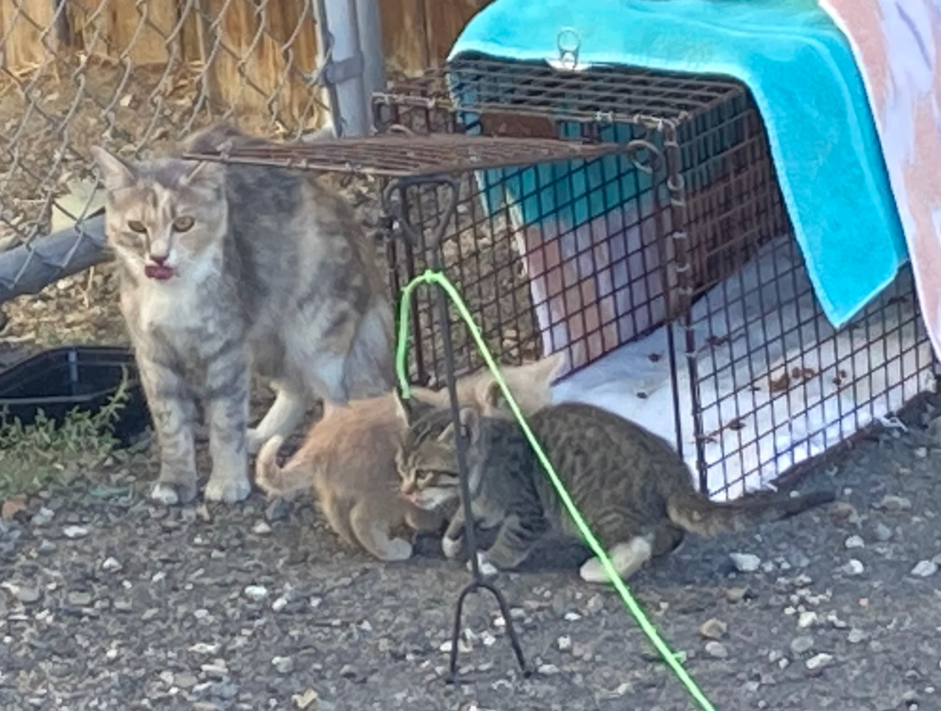
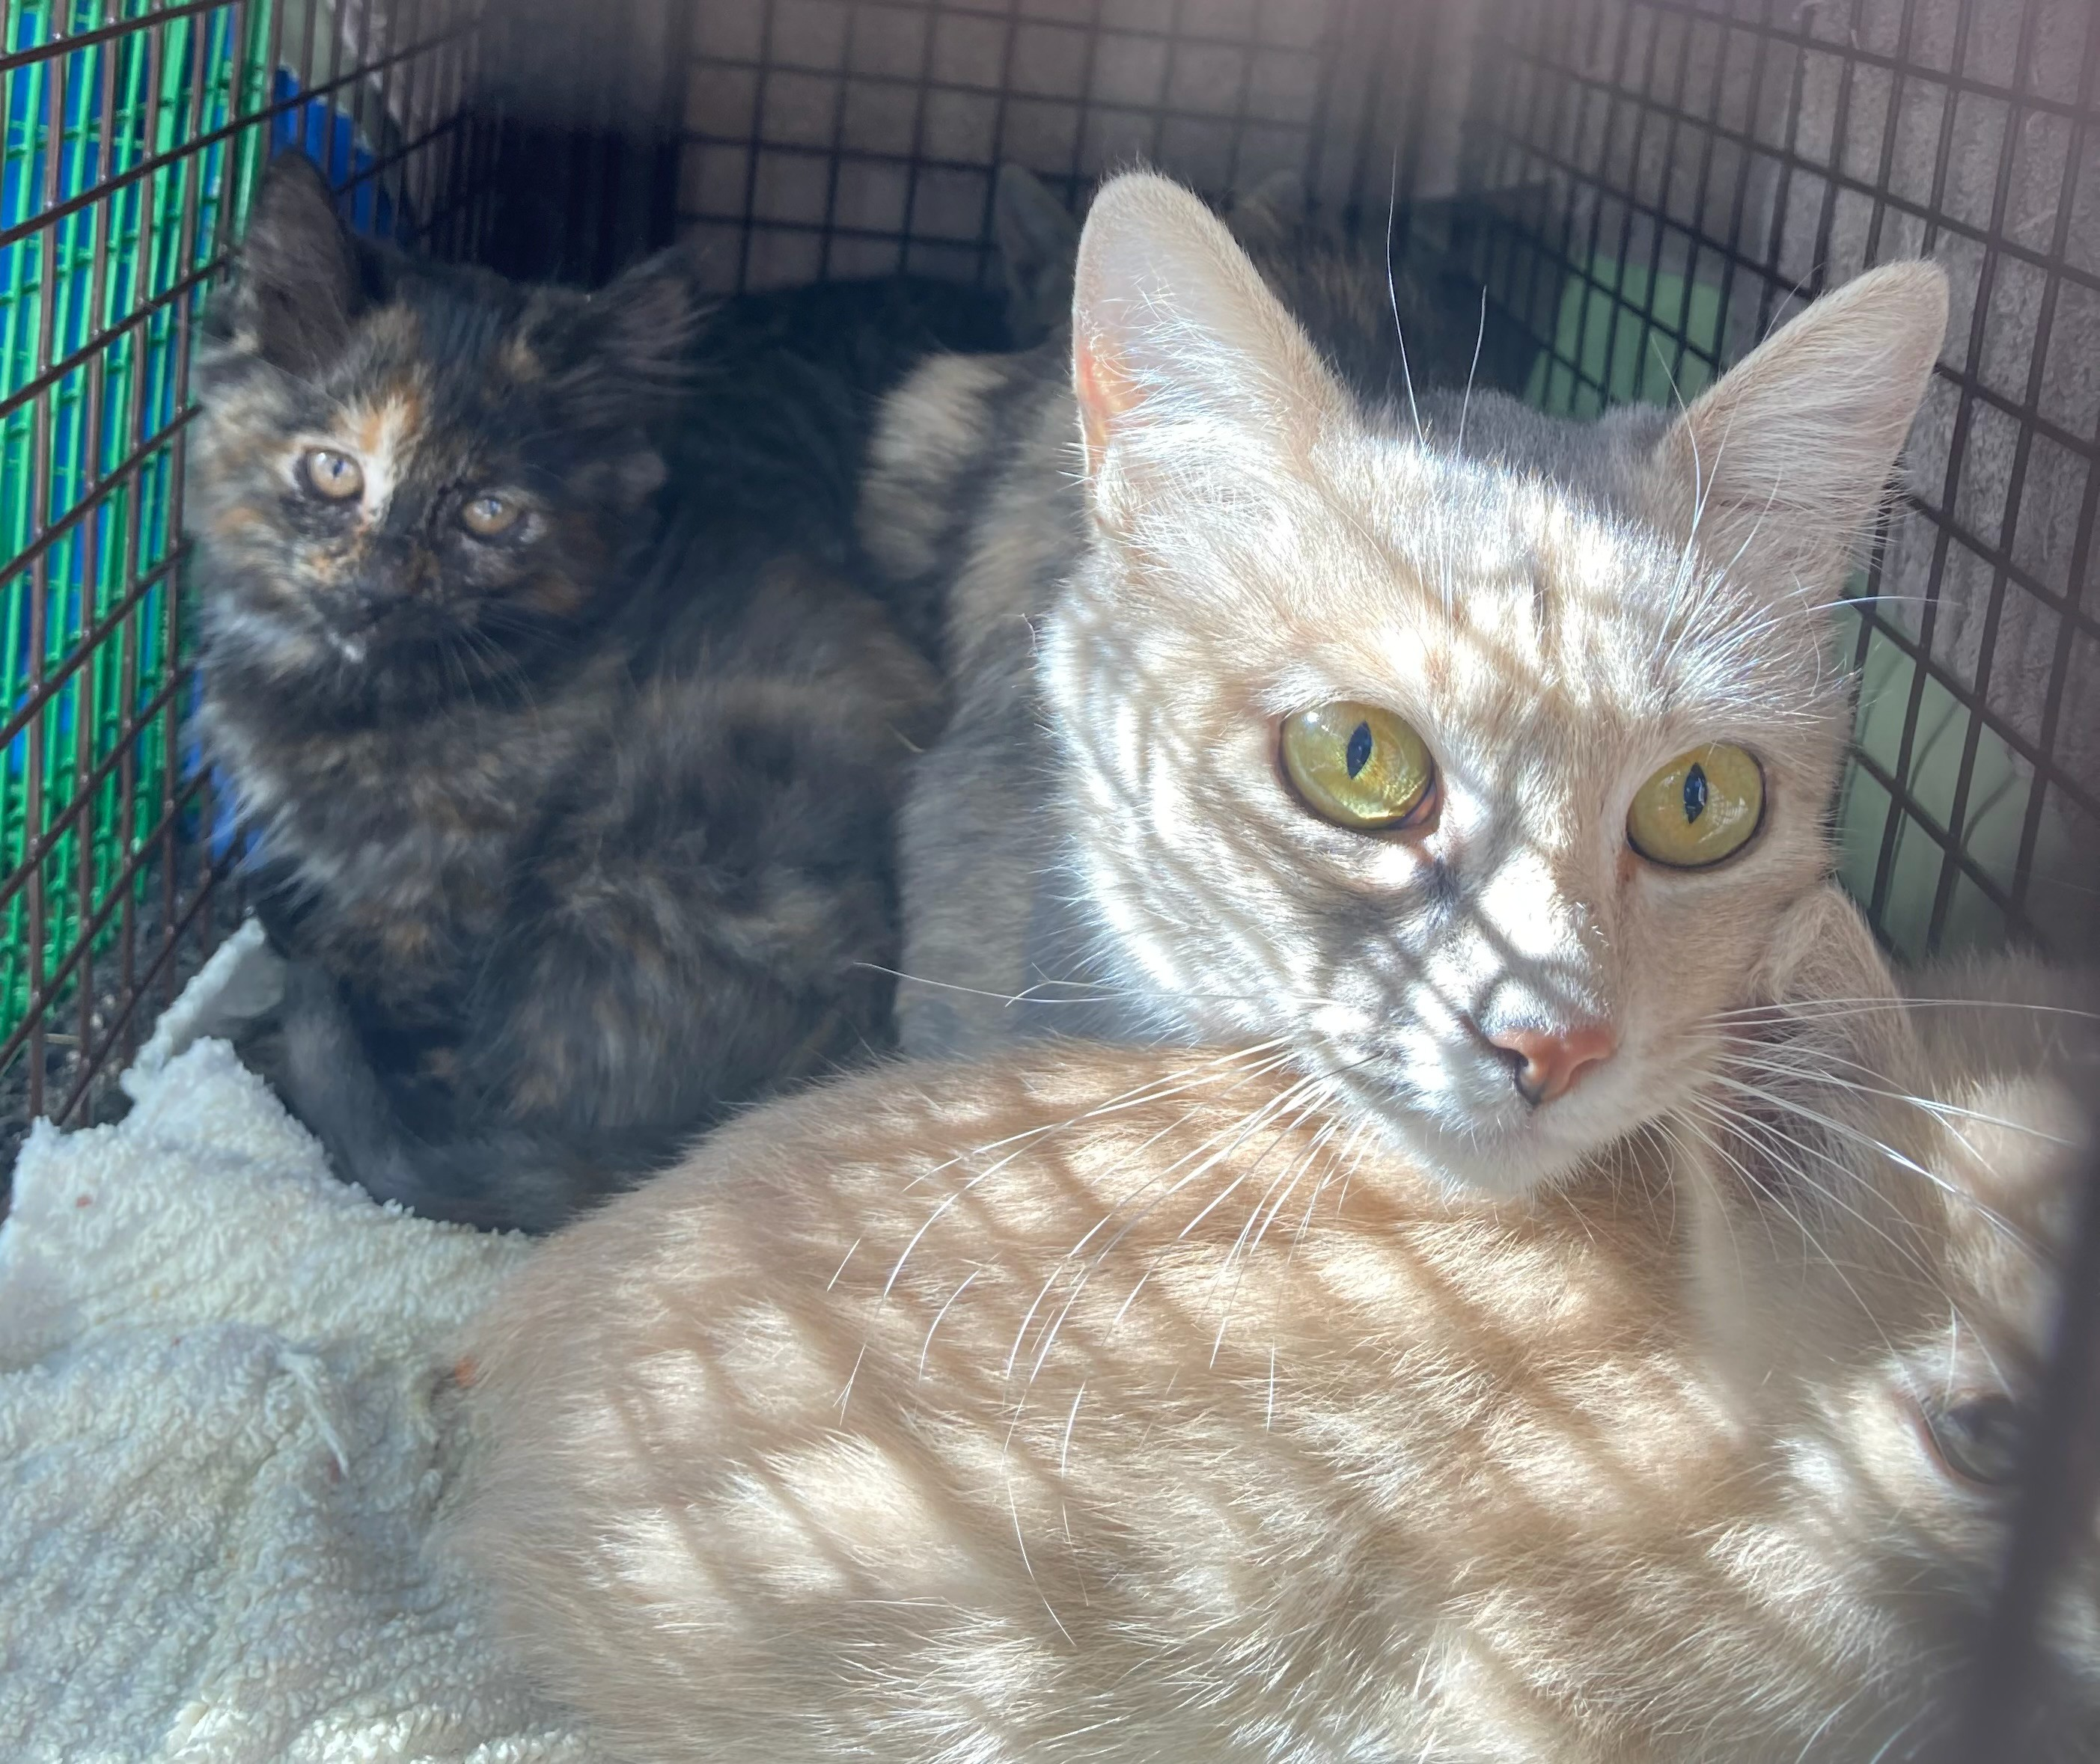
“The best solution to [community cat] issues is going to be significant changes in how people care for their cats.”
John Boone, PhD
Alliance for Contraception in Dogs and Cats Board of Directors Community Cats Podcast
NO-KILL STARTS WITH TNR
TNR is not a niche; it is THE answer to free roaming cat population control.
We cannot adopt our way out of this.

Slide 7
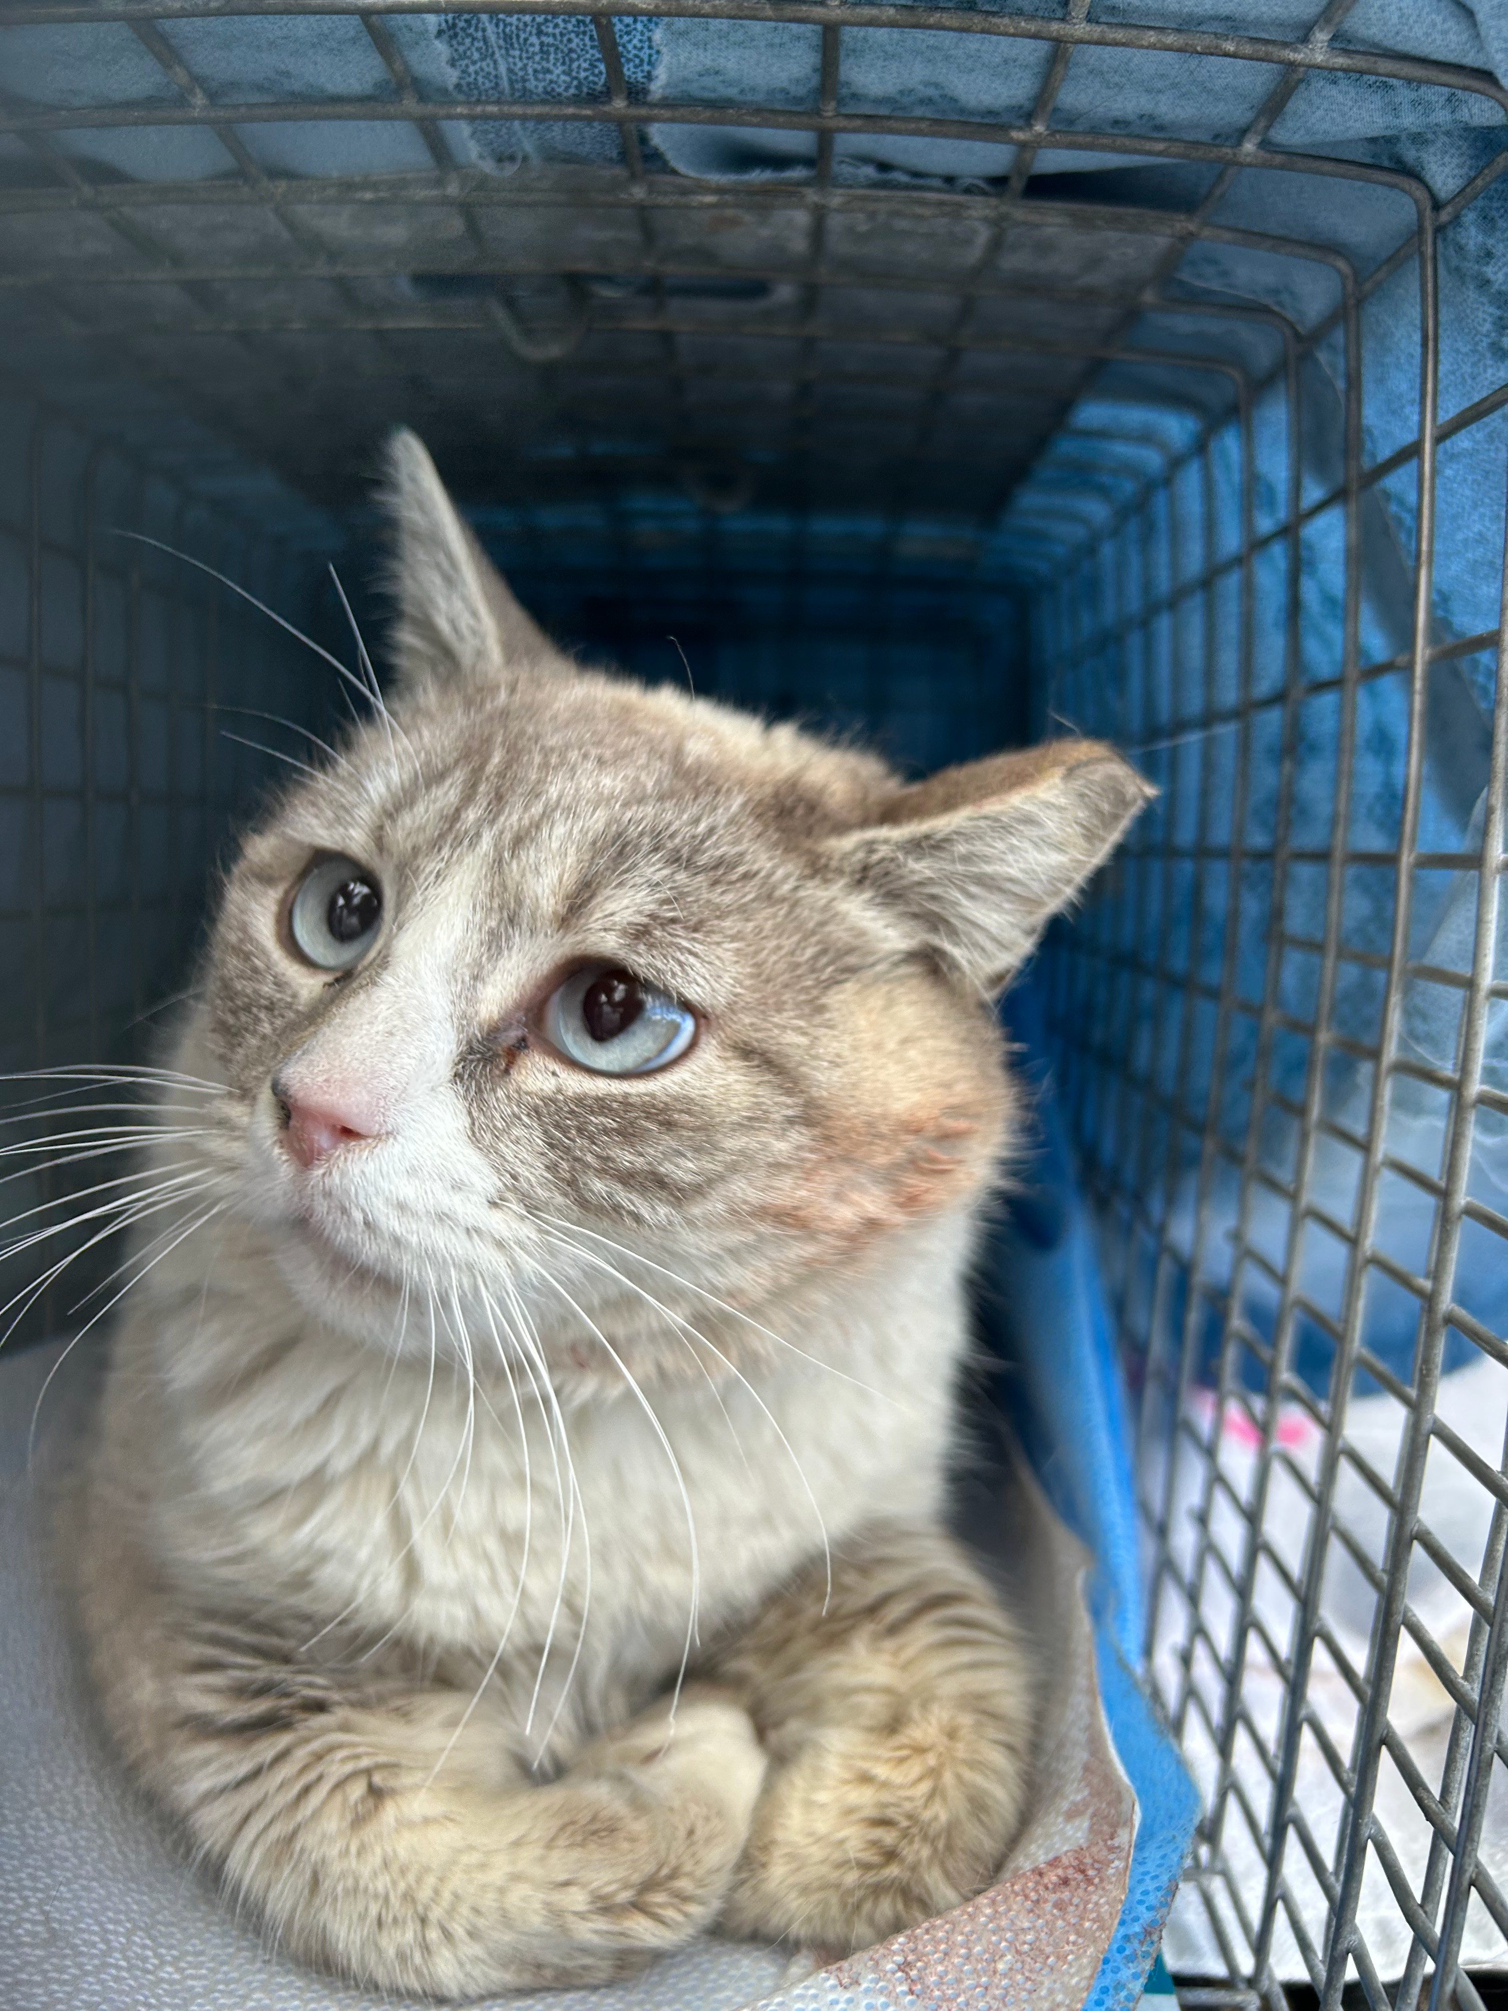
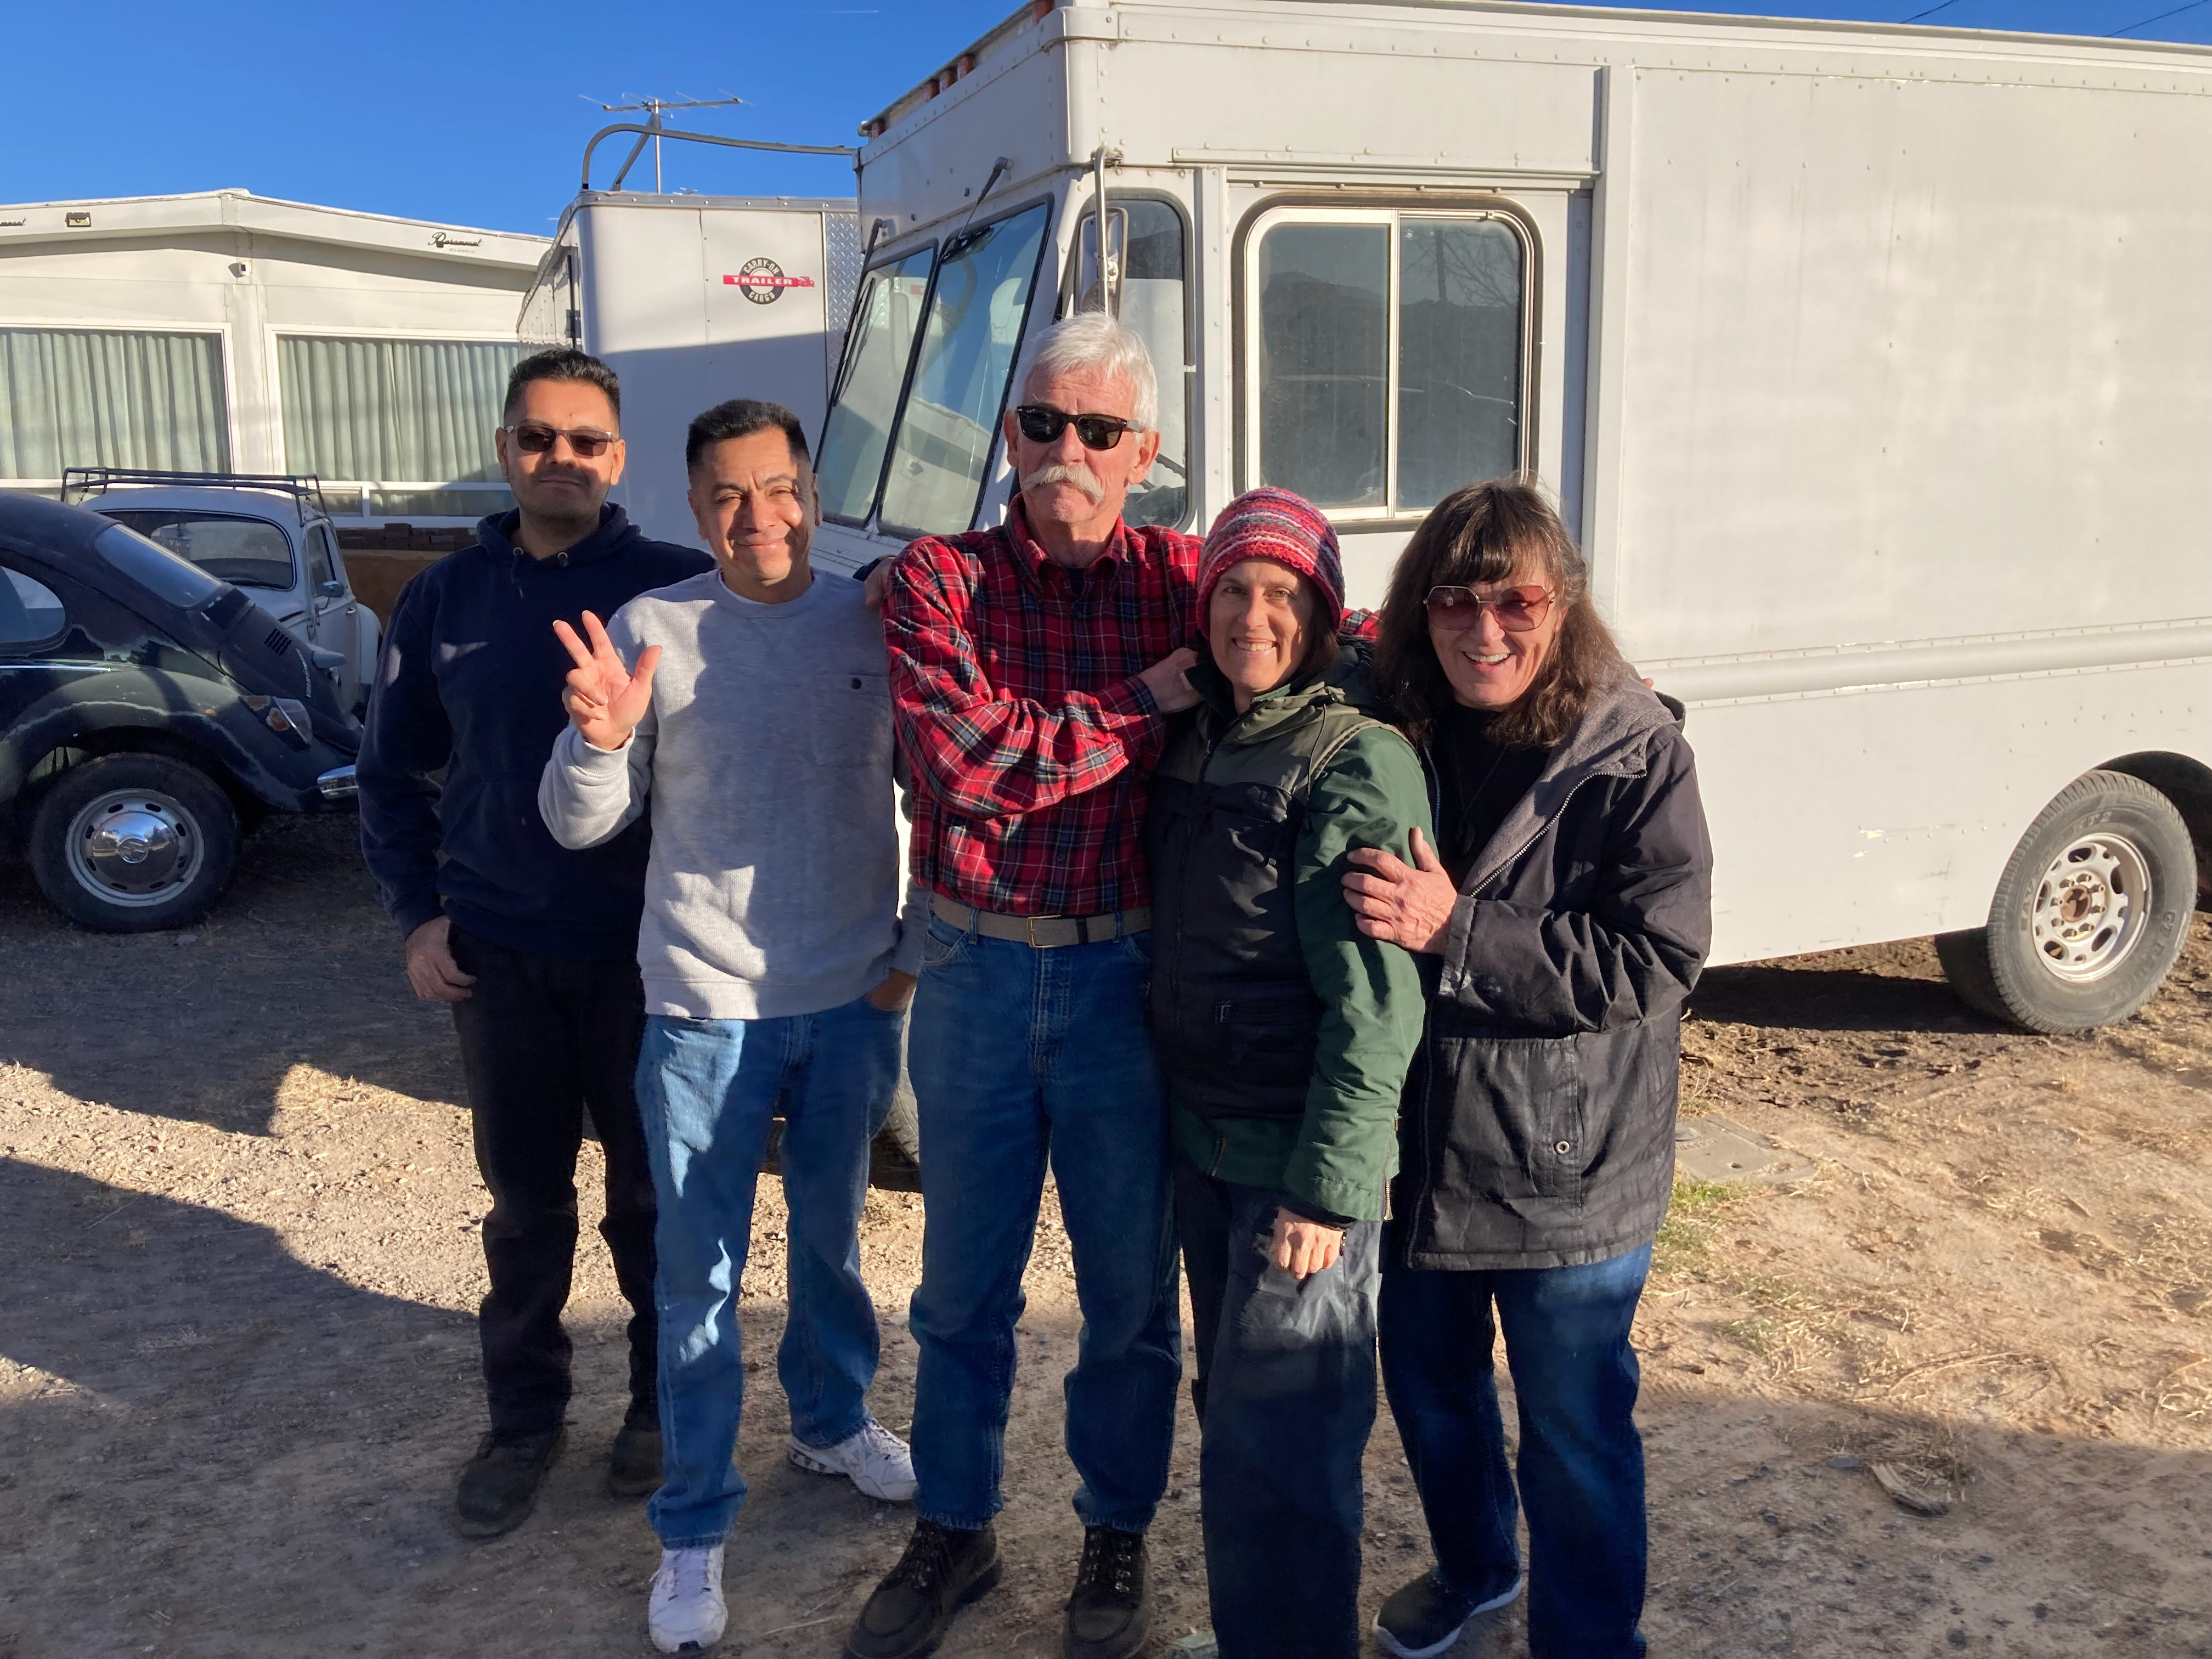
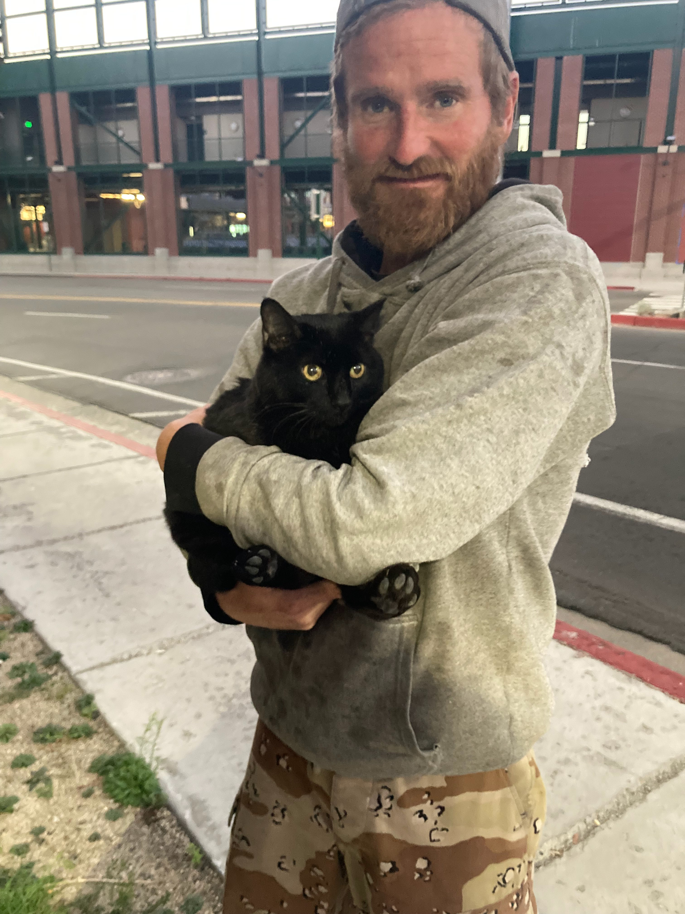
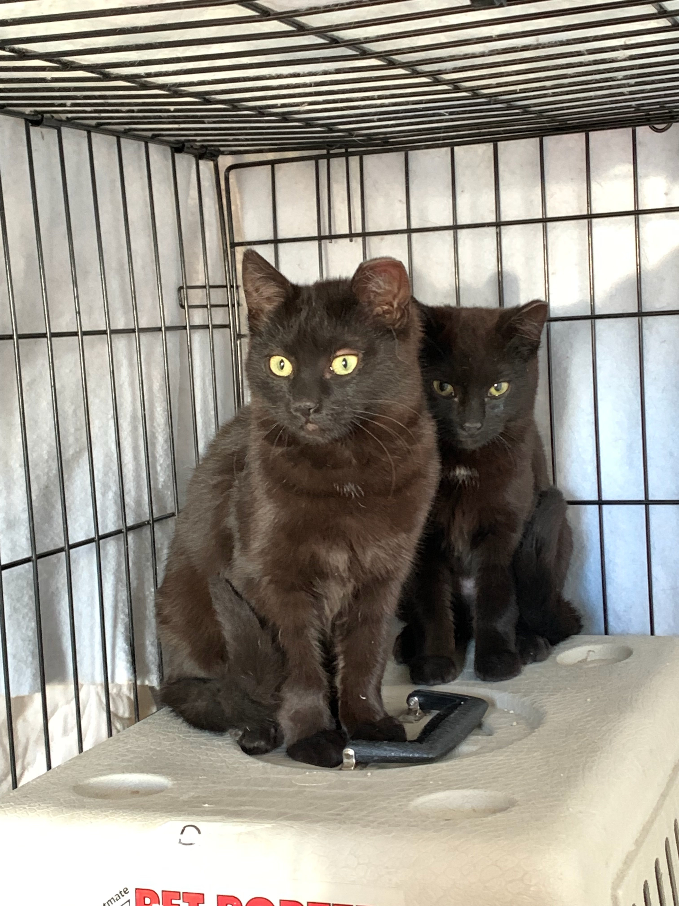
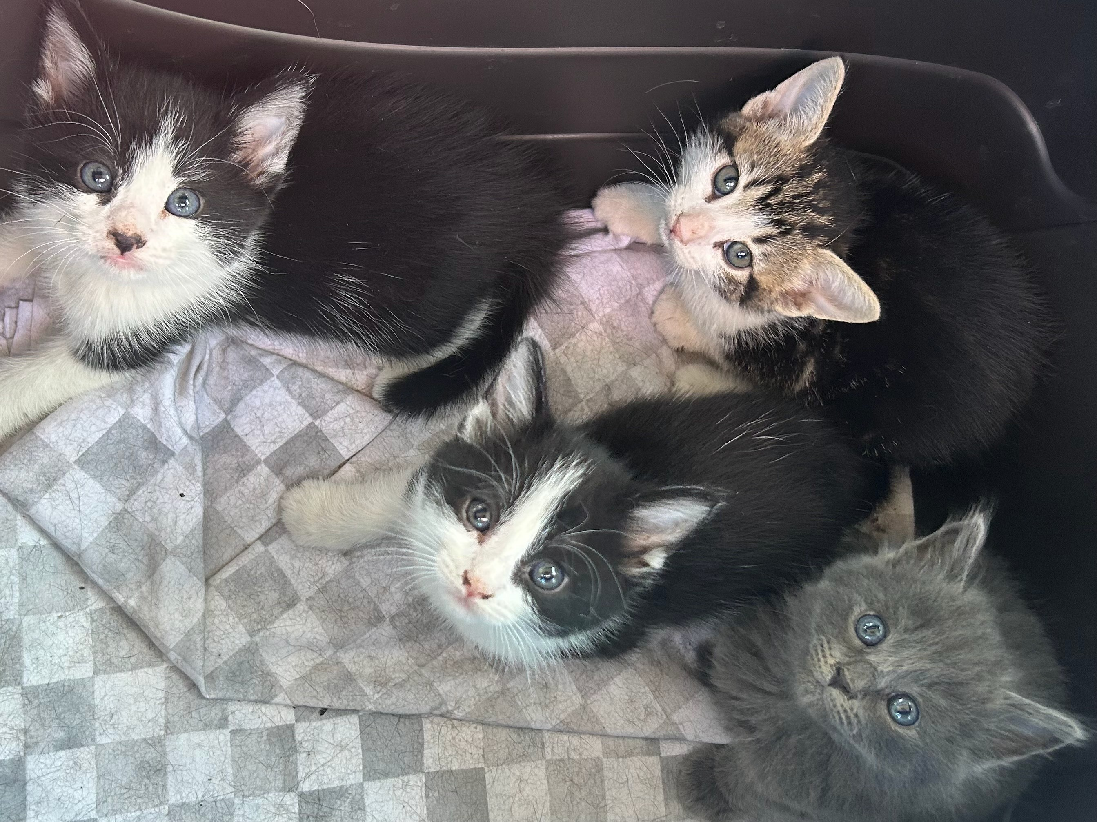
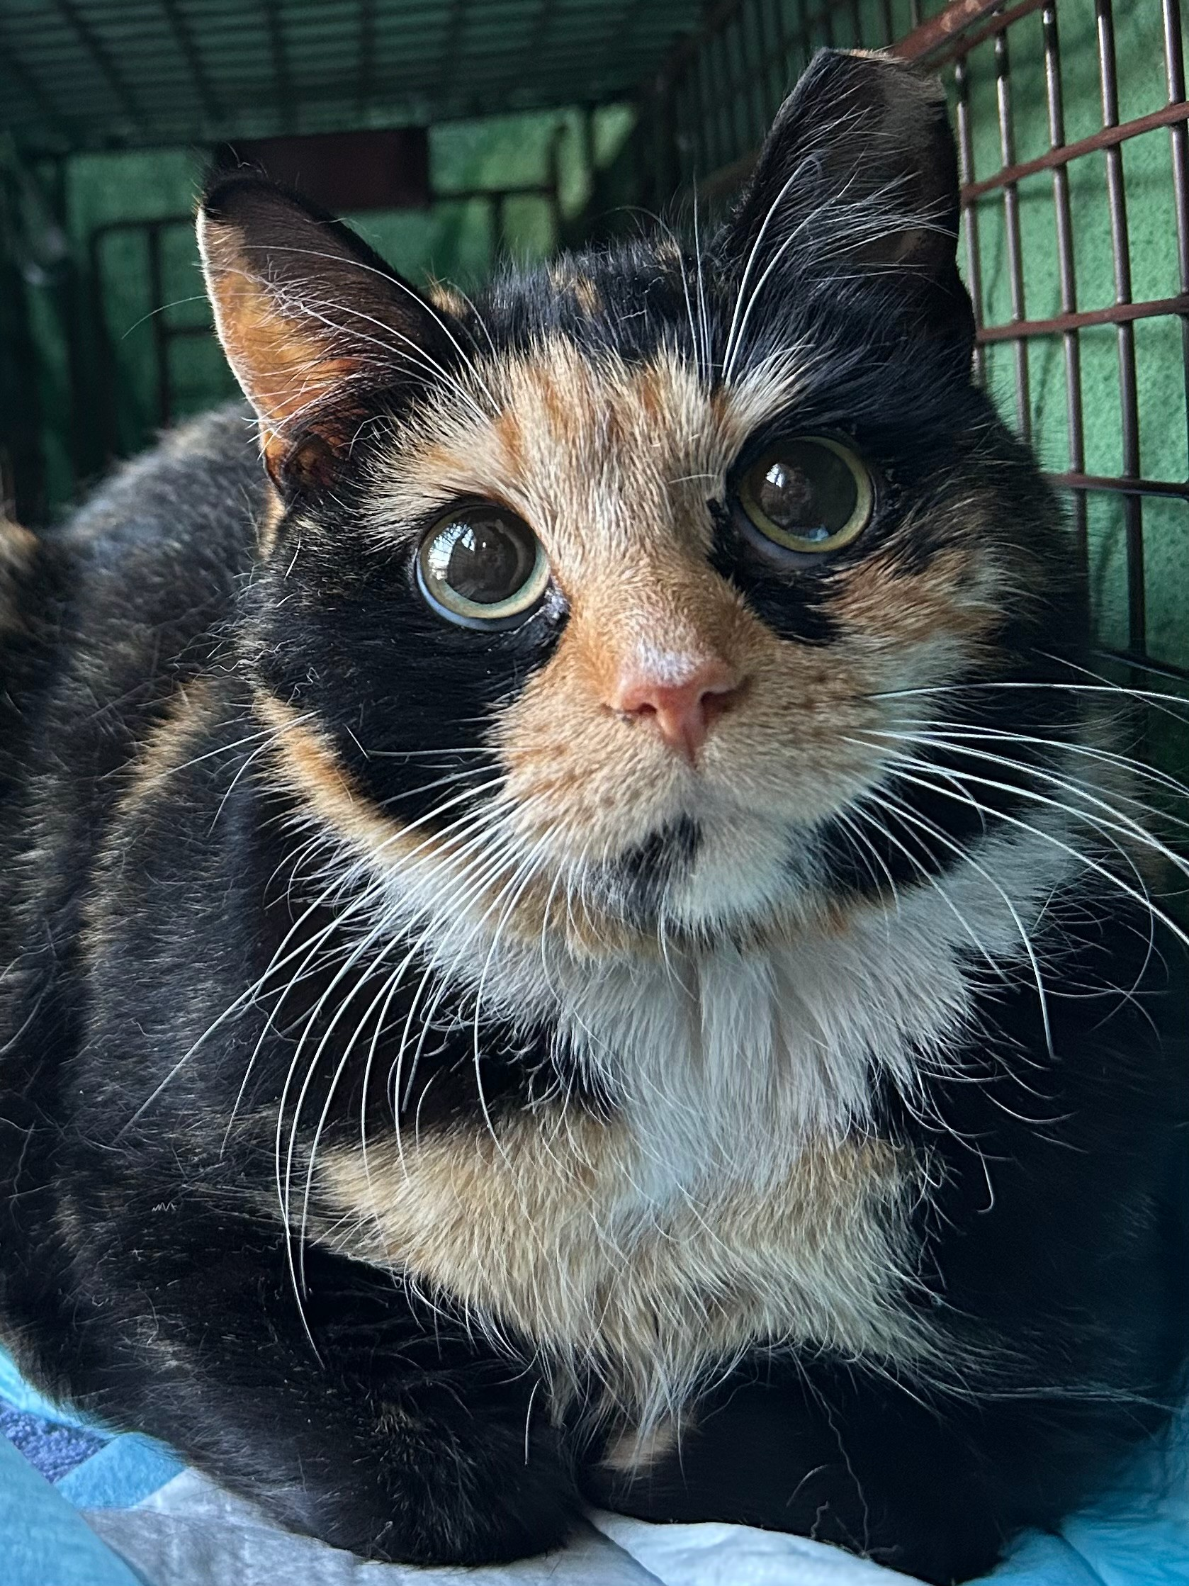
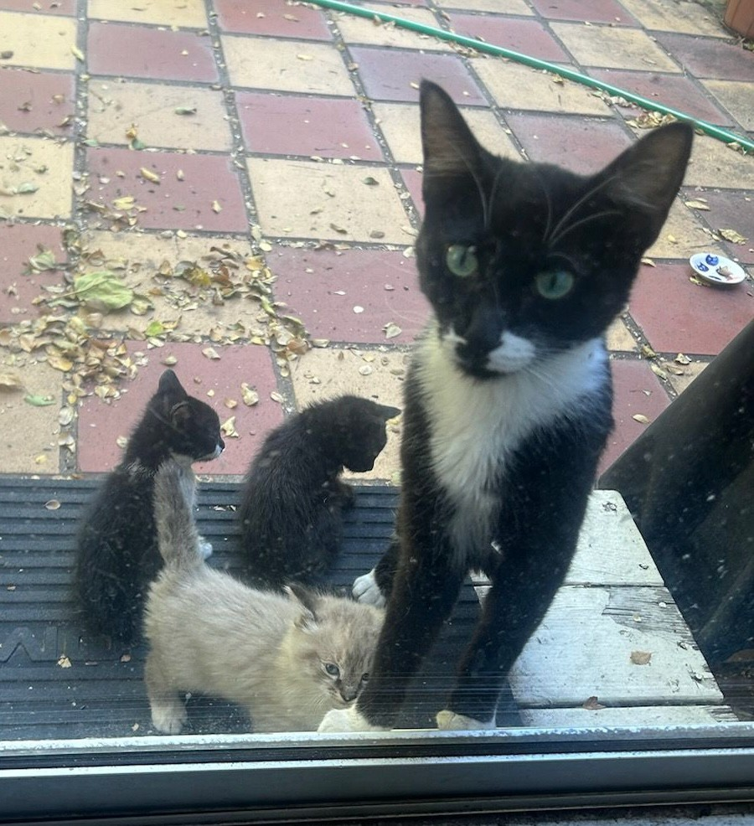
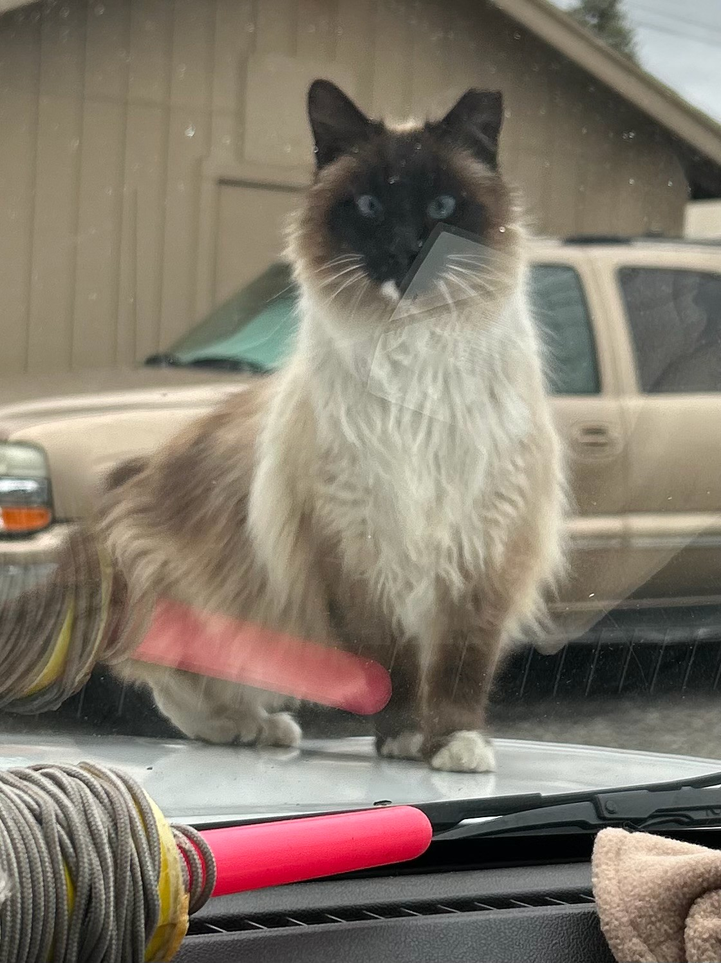
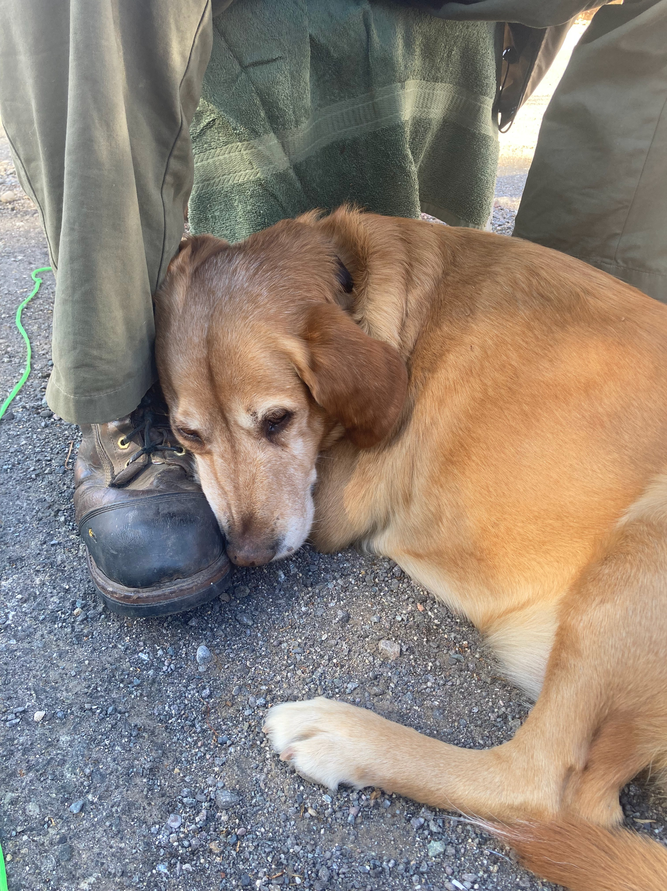
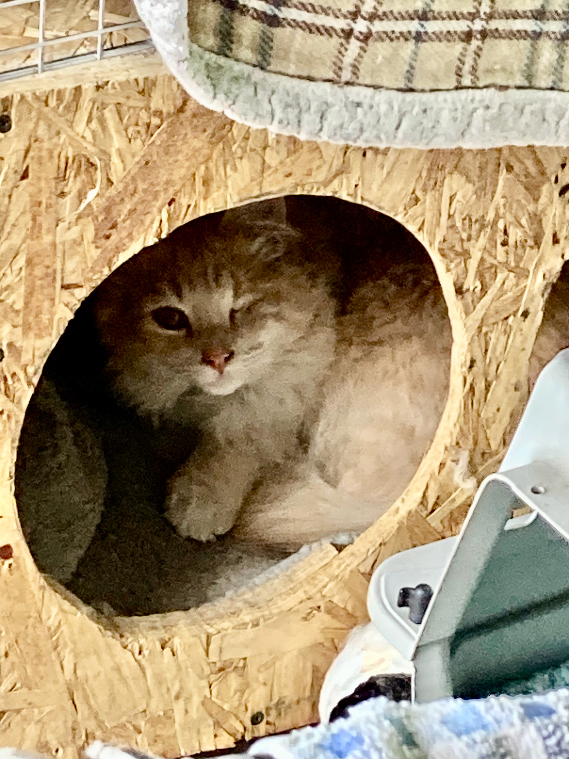
Faces of TNR

